Slide 1
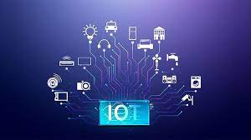
IOT
INTERNET OF THINGS

Slide 2
INTRODUCTION
What is IoT? The Internet of Things (IoT) describes the network of physical objects—“things”—that are embedded with sensors, software, and other technologies for the purpose of connecting and exchanging data with other devices and systems over the internet.

Slide 3
TECHNOLOGY
Access to low-cost, low-power sensor technology. Affordable and reliable sensors are making IoT technology possible for more manufacturers.
Connectivity. ...
Cloud computing platforms. ...
Machine learning and analytics. ...
Conversational artificial intelligence (AI).

Slide 4
HOW IT WORKS
IoT devices share the sensor data they collect by connecting to an IoT gateway or other edge device where data is either sent to the cloud to be analyzed or analyzed locally. Sometimes, these devices communicate with other related devices and act on the information they get from one another.

Slide 5
APPLICATIONS OF IOT
IoT allows you to connect all your home applications like air conditioners, lighting, locks, thermostat, theft alarm systems, and whatnot into a single system and have the control at your fingertips with a smartphone. It is predicted that by 2023, 309M homes worldwide will have smart systems installed

Slide 6
ADVANTAGES OF IOT
Reduced costs.
Higher efficiency and productivity.
More business opportunities.
Improved customer experience.
Increased mobility and agility.

Slide 7
THANK YOU

